Slide 1
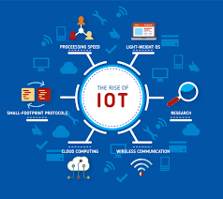
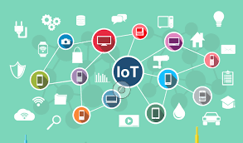
WHAT IS INTERNET OF THINGS
The Internet of Things is an emerging topic of technical, social, and economic significance. Consumer products, durable goods, cars and trucks, industrial and utility components, sensors, and other everyday objects are being combined with Internet connectivity and powerful data analytic capabilities that promise to transform the way we work, live, and play. Projections for the impact of IoT on the Internet and economy are impressive, with some anticipating as many as 100 billion connected IoT devices and a global economic impact of more than $11 trillion by 2025.

Slide 2
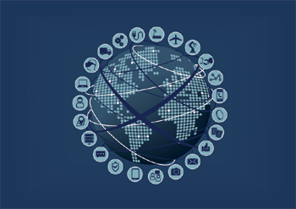
HISTORY OFINTERNET OF THINGS
In 1991, about 15 academics at Cambridge University were sharing a coffee machine. The academicians, whose offices were on the lower floor of the building, were bored of climbing up dozens of stairs and seeing the empty coffee machine, so they developed a system where they could see the machine. The system captured three images of the machine per minute and sent them to the computers on their desks. By this way, the amount of coffee in the machine could be seen.Kevin Ashton used the concept of the Internet of Things for the first time in 1999 in a presentation prepared for Procter & Gamble. In the presentation, the benefits of radio frequency and identification technology were explained and recommended to the company. The technology that has developed in the following years has enabled billions of people to connect to Internet with computers or mobile devices. The expected big step after this phase is that computers connected to each other exchange information with objects connected to each other. In the future, it is expected that all things/objects from cars to books, from electronic devices to food, from intelligent buildings to shoes will be able to connect to each other.

Slide 3
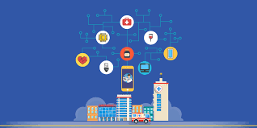
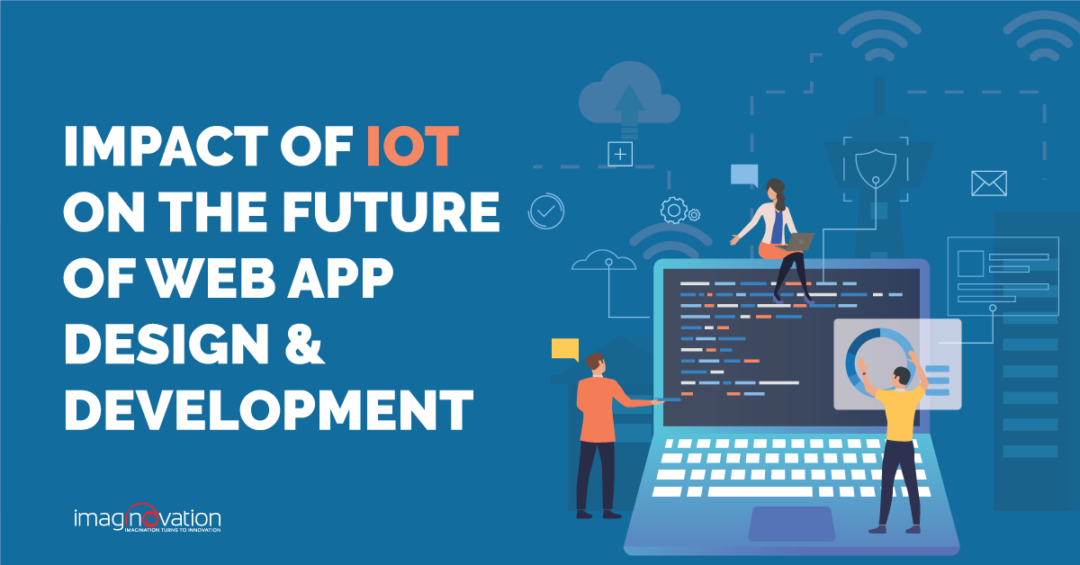
WHAT IS ITS IMPACT
The positive impact of the IoT on citizens, businesses and governments will be significant, ranging from helping governments reduce healthcare costs and improving quality of life, to reducing carbon footprints, increasing access to education in remote underserved communities, and improving transportation safety.
The expected value added impact of the IoT by 2020 is estimated to be in the region of 4.5 Trillion USD (Machina Research), including both revenue opportunities and cost savings that may be generated.

Slide 4
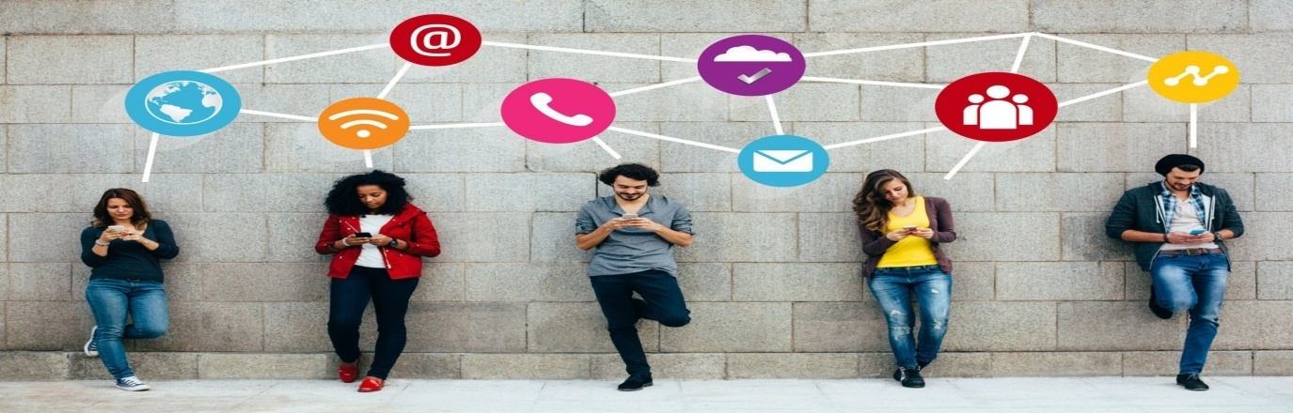
What is its impact going to be in the future?
The Internet of Things (IoT) industry is growing rapidly with the number of IoT-connected devices projected to surpass 20 billion by 2020. It’s an amazing number, but a number that wouldn’t be possible without the concurrent growth and availability of Wi-Fi and cellular. However, even with all this growth, industry leaders don’t believe existing Wi-Fi and cellular capabilities can keep up with IoT’s trajectory. Thankfully, a little innovation called 5G is on the way. Offering the technological boost needed to sustain this growth, the imminent arrival of 5G presents valuable opportunities for IoT. Let’s take a look at where IoT is today, and what the future holds. Smart cities are in the near future To be considered 'smart', a city has to have a minimum level of wireless connectivity available and the ability to integrate IoT within their infrastructure. How can this be applied to our everyday lives? In just one example, the data provided by IoT-connected smart cities can make finding a parking spot a whole lot easier. If that doesn’t sound like a big deal, IoT in a smart city can also aid broader concerns like sanitation and energy efficiency.

Slide 5
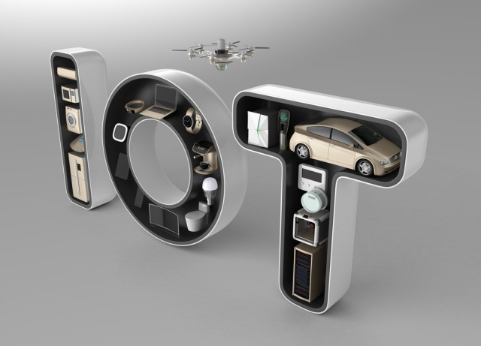
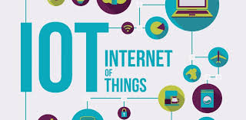
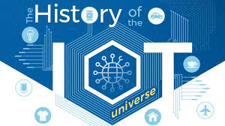
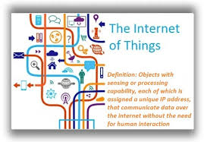
Reference

